Slide 1
Full Stack Developer

Slide 2
Basic Computer Science

Slide 3

By the end of this lesson, you will be able to:
Elaborate Software development models
Comprehend Software evolution
Analyze Software Development Paradigm
Apply Software Development life cycle

Slide 4
Basic Computer Science

Slide 5
Software Evolution

Slide 6


Software Evolution
Software evolution, also known as the s/w engineering paradigm, is the process of creating a software product utilising software engineering ideas and methods.
The process of evolution begins with the gathering of requirements. The developers then produce a prototype of the anticipated programme and exhibit it to users to collect feedback early in the software development process.

Slide 7
Software Evolution
It comprises the initial development of software, as well as its maintenance and updates, until the intended software product meets the expected requirements.
The process of evolution begins with the gathering of requirements. The developers then produce a prototype of the anticipated program and exhibit it to users to collect feedback early in the software development process.
Users recommend modifications, which are then implemented in a series of updates and maintenance. This procedure modifies the original software until the desired software is achieved.

Slide 8
Software Development Paradigm

Slide 9


Software Development Paradigms
The Paradigm is known as software engineering paradigms where all the engineering concepts pertaining to the development of software are applied. It includes various researches and requirement gathering which helps the software product to build.

Slide 10

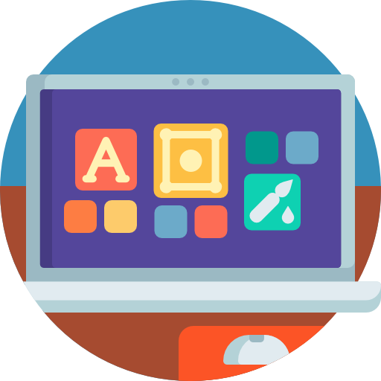
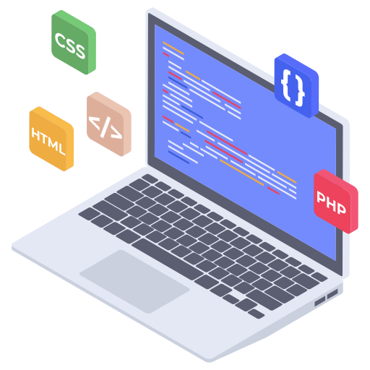
Software Development Paradigms
It consists of :
Requirement gathering
Software design
Programming

Slide 11
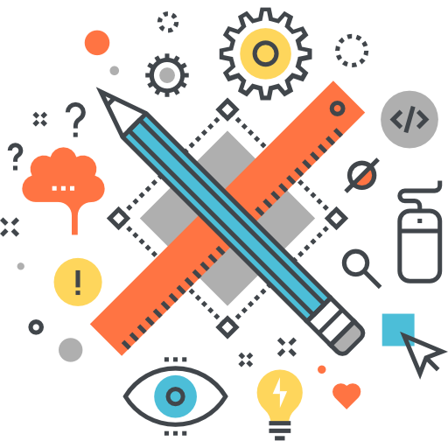


Software Design Paradigms
This paradigm is a part of Software Development and includes:
Design
Maintenance
Programming

Slide 12
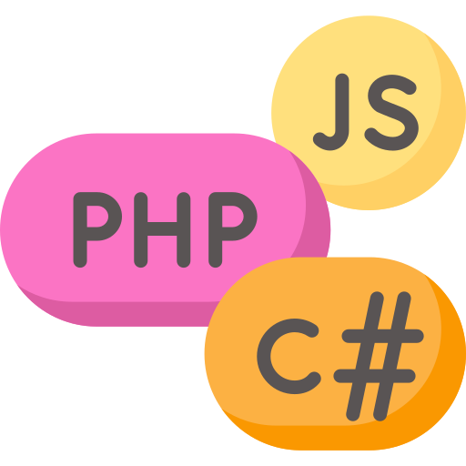

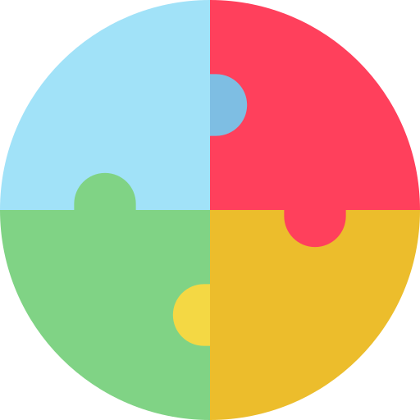
Programming Paradigms
This paradigm is related closely to programming aspect of software development. It also includes:
Coding
Testing
Integration

Slide 13
Software Development Life Cycle

Slide 14

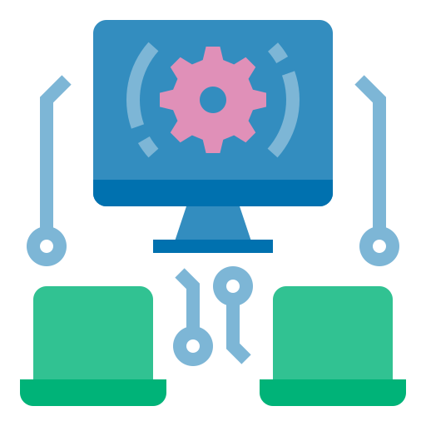

Software Development Life Cycle
The purpose of the Software Development Life Cycle (SDLC) is to generate a large system that satisfies customer expectations, performs effectively and efficiently in current and projected information technology infrastructure, and is economical to maintain and enhance.

Slide 15
Software Development Paradigms
The process of software development are:
Planning
Deployment
Defining
SDLC
Testing
Designing
Building

Slide 16
Software Development Paradigms
Planning:
The first duration of a development project is included in software development planning.
Analysis and planning, ideation, design and development, deployment, production and launch, and maintenance are all included in the plan.
Defining:
It defines the logical framework of each module as well as the interface used to connect with it.

Slide 17
Software Development Paradigms
Designing:
Design decisions depend on the requirements list you created during the definition phase.
One or more designs are generated during the design process to accomplish the project's goal.
Implementing:
User notification, training, hardware installation, software installation on production computers, and system integration into regular work activities are all part of the implementation process.

Slide 18
Software Development Paradigms
Testing:
In the software development lifecycle (SDLC), the testing phase is where you focus on research and discovery. During the testing phase, programmers check to see if their code and programming meet the needs of the customer.
Deployment:
The software development life cycle (SDLC) closes with the deployment phase, which puts the product into business.

Slide 19
Software Development Life Cycle
Some of the reasons why SDLC is important in Software Development are:
It provides visibility of a project plan to all the involved stakeholders.
It helps us to avoid project risks.
It allows us to track and control the project.
It doesn’t conclude until all the requirements have been achieved.

Slide 20
Software Development Models

Slide 21


Software Development
A set of activities for specifying, designing, implementing and testing software systems for associated outcome that produce a software product.

Slide 22
Software Development
These are four key process activities, which are common to all software processes and the activities are:
Software
Specification
Development
Validation
Evolution

Slide 23
Software Development Model
The software development process is based on the SDLC model.
SDLC is a pictorial and diagrammatic representation of the software life cycle.
The models specify the various stages of the process in which they are carried out.
There are multiple SDLC models. They are divided into main groups, each with its features and weaknesses.
Notes:
One of the basic notions of the software development process is SDLC model.
SDLC is a pictorial and diagrammatic representation of the software life cycle.
The models specify the various stages of the process in which they are carried out.
There is no one single SDLC model.
They are divided into main groups, each with its features and weaknesses.

Slide 24
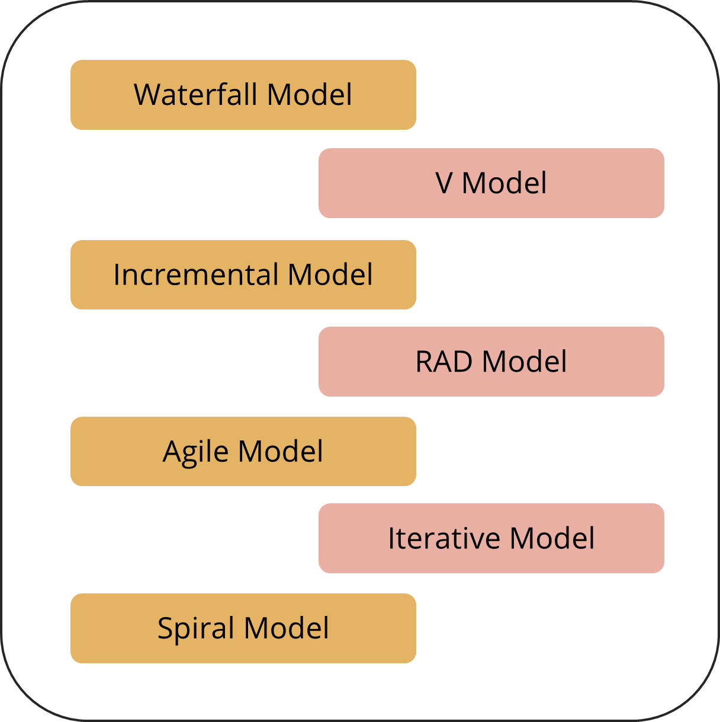
Software Development Model
The most used, popular and important SDLC models are given below:

Slide 25


Waterfall Model
The waterfall is a cascade SDLC model that includes gradual executions of phases.
The waterfall model is a breakdown of project activities into linear sequential phases.
Each phase depends on the deliverables of the previous phase. The approach is typical for certain areas of engineering design.
This process is documented and predefined with features expected to every phase.

Slide 26
Waterfall Model
The different steps of the Waterfall model are:
Requirement Analysis
System Design
Implementation
Testing
Deployment
Maintenance

Slide 27
Waterfall Model
The use cases are:
Small to mid-sized projects with well-defined, recurring needs (small company website development)
Projects that require a greater level of control, and a more predictable budget and timeframe (e.g., governmental projects)
Healthcare projects where multiple rules and procedures must be maintained when working on a task
Projects that make use of some good software platform and tools

Slide 28


V Model
V-shaped SDLC model is an expansion of classic waterfall model.
This model is based on associated test stage for every development stage.
This is a very strict model, and the next stage is started only after the previous phase.
This is also called “Validation and verification” model.
The horizontal axes represent time or project completeness (left-to-right).
The vertical axes represent level of abstraction (coarsest-grain abstraction uppermost).

Slide 29
V Model
The different steps of the V model are:
Requirements
Acceptance Testing
Planning
Specifications
System Testing
High Level Design
Integration Testing
Low Level Design
Unit Testing
Coding

Slide 30

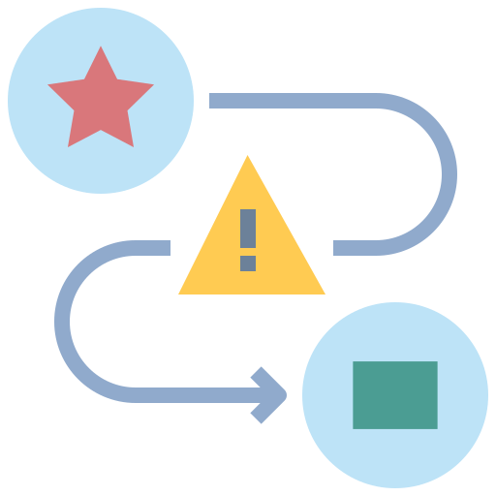
V Model
V models are used in projects where downtime and failures are unacceptably high. For example, medical software and aviation fleet management software.

Slide 31

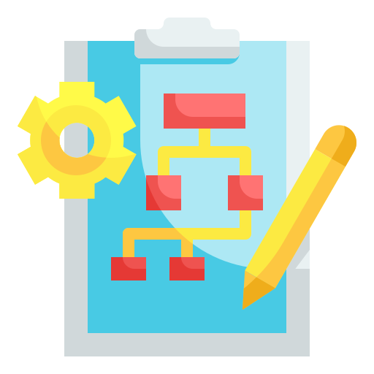
Incremental Model
The incremental model is a software development process that distributes requirements into multiple stand-alone modules during the software development cycle.
Analysis, implementation, testing, and maintenance are the steps in this model.
Each iteration goes through the processes of requirements, design, coding, and testing.
It includes both development and upkeep.

Slide 32

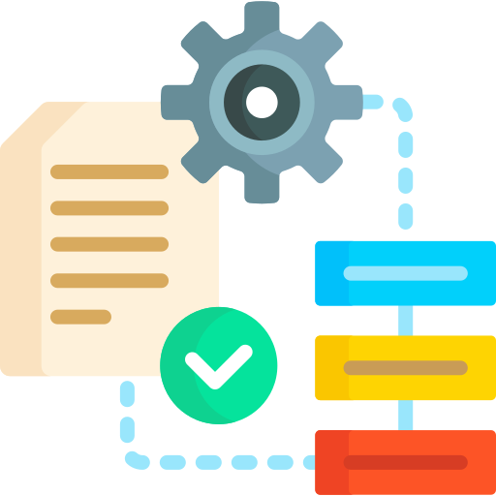
Incremental Model
When a product meets all its specifications, it is said to be finished.
This approach combines parts of the waterfall model with prototyping iteration.
When the first increment is achieved, the system is put into production.
The development of a system is split down into several smaller tasks. The most important criterion is addressed first.

Slide 33
Incremental Model
Incremental Model
Incremental Model
The different steps of the Incremental model are:
Increment - 1
Increment - 1
Increment - 1
Code
Increment - 1
Code
Code
Code
Test
Test
Test
Design
Test
Design
Design
Analysis
Design
Analysis
Analysis
Analysis
Increment - 2
Increment - 2
Increment - 2
Code
Increment - 2
Code
Code
Code
Test
Test
Test
Design
Test
Design
Design
Analysis
Design
Analysis
Analysis
Analysis
Increment - 3
Increment - 3
Increment - 3
Code
Increment - 3
Code
Code
Code
Test
Test
Test
Design
Test
Design
Design
Analysis
Design
Analysis
Analysis
Analysis

Slide 34

Incremental Model
The use case is:
Large, mission-critical enterprise programs made from loosely linked components like microservices or web services

Slide 35
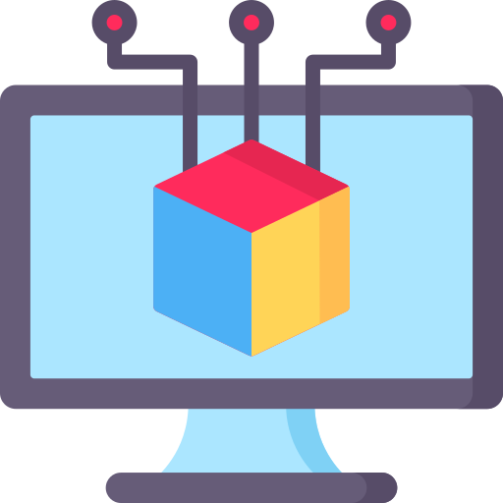
RAD Model
Adaptive software development is another term for rapid application development. The incremental prototyping technique to software development is known as RAD.
When reviewing a live system, end users can provide better input here. It places a greater emphasis on adaptability rather than planning.

Slide 36


RAD Model
RAD is a concept that states that by gathering needs through workshops or focus groups, goods may be built faster and with higher quality.
It involves design prototyping and early iterative user testing.
Software component reuse is a term used to describe the process of reusing software components.
In evaluations and other team interactions, there is less formality.

Slide 37
RAD Model
The different steps of the RAD model are:
Refine
Prototype
Requirements Planning
Construction
Cutover
User Design
Test

Slide 38
RAD Model
The use cases are:
RAD should only be utilized when a system can be modularized and deployed incrementally.
It is being used if there are many designers available for modeling.
It should only be utilized if the budget does not allow for the usage of automated code generation technologies.

Slide 39
RAD Model
The use cases are:
It should be utilized when project requirements change and workable prototypes are provided to customers in small iterations of 2-3 months.
RAD SDLC model should only be used if domain specialists with appropriate business knowledge are available.

Slide 40


Agile Model
A software development approach based on iterative development is referred to as "agile process model."
Agile methodologies separate projects into smaller iterations, or sections, and avoid long-term planning.

Slide 41

Agile Model
Customers can view the result of each development iteration in the Agile methodology and decide if they are satisfied or not.
The scrum methodology is one of the Agile model's practical applications.
The alternatives to traditional project management are suggested by the Agile movement.

Slide 42

Agile Model
Agile software development is often carried out in short, quick cycles.
With each release, the frequency of incremental releases increases.
To guarantee that software quality is maintained, extensive testing is performed.
Many frameworks, such as Scrum, Kanban, Lean, and Extreme Programming (XP), can help organizations become more agile.

Slide 43
Agile Model
The different steps of the Agile model are:
Requirements
Test and Feedback
Architecture and Design
Development

Slide 44
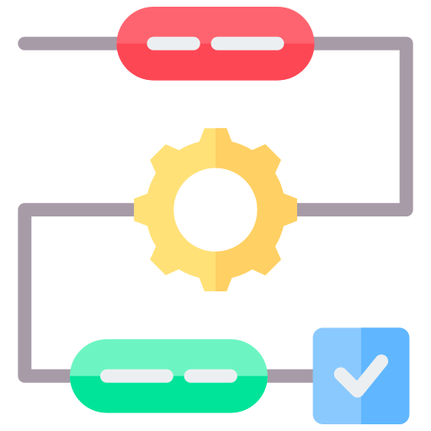

Iterative Model
The Iterative Model allows the team to go back in time and visit prior phases where the changes were made. When the Software Development Life Cycle (SDLC) procedure is completed, the project's final result is renewed.

Slide 45

Iterative Model
The iterative model does not need a full list of requirements before starting a project.
The development process may start with the requirements of the functional part.
The process is repetitive, allowing it to make new versions of the product for every cycle.

Slide 46

Iterative Model
Every iteration includes the development of a separate component of the system.
After that, this component is added to the functional part developed earlier.
However, in an iterative project, a formal software specification may also be required.

Slide 47
Iterative Model
The different steps of the Iterative model are:
Analysis
Design
Coding
Testing
Implementation

Slide 48

Spiral Model
The spiral model is a stage-based SDLC approach that integrates architecture and prototyping. It is a hybrid of the Iterative and Waterfall SDLC models, with a strong focus on risk assessment.

Slide 49

Spiral Model
Process:
In this model, the proper time to progress to the next stage must be determined.
The solution to this problem is to use the pre-determined time frames.
The transition to the next level takes place as planned.
Even if the earlier stage's work is still not completed.
The strategy is based on statistical data gathered from past projects.

Slide 50
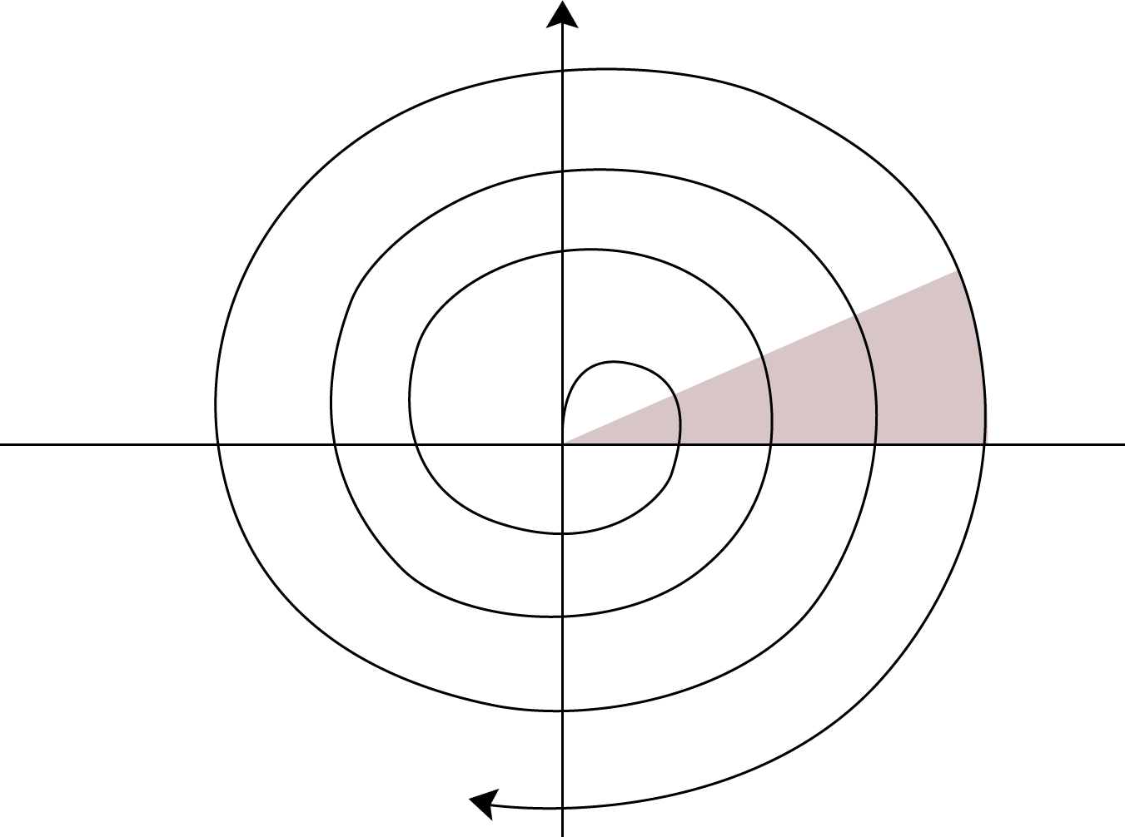
Spiral Model
Cumulative Cost Progress
Determine Objectives
2. Identity Risks
Review
Requirements
Plan
Concept of
Requirements
Prototype 1
Prototype 2
Operational
Prototype
Concept of Operation
Requirements
Detailed
Design
Development Plan
Verification & Validation
Code
4. Plan the Next Iteration
Test Plan
Integration
Test
3. Development and Test
Release
Implementation

Slide 51
Software development is a set of activities for specifying, designing, implementing, and testing software systems.
SDLC models are Waterfall model, V model, Incremental model, RAD model, Agile model, Iterative model, and Spiral model
The Paradigm is known as software engineering paradigms where all the engineering concepts pertaining to the development of software are applied.
Software Development life cycle aims to produce a high-quality system that meets or exceeds customer expectations, works effectively in the current and planned information technology infrastructure.

Slide 53
Which model can be selected if a user is involved in all the phases of SDLC?
1
Waterfall Model
Prototyping Model
RAD Model
Both B and C

Slide 54
Which model can be selected if a user is involved in all the phases of SDLC?
1
Waterfall Model
Prototyping Model
RAD Model
Both B and C
C
RAD Model can be selected if a user is involved in all the phases of SDLC.

Slide 55
Which of these software activities is not a part of software processes?
2
Software Development
Software Dependence
Software Validation
Software Specification

Slide 56
Which of these software activities is not a part of software processes?
2
Software Development
Software Dependence
Software Validation
Software Specification
B
Software dependence is not a part of software processes .

Slide 57
What is the simplest model of software development paradigm?
3
Spiral Model
Agile Model
V Model
Waterfall Model

Slide 58
What is the simplest model of software development paradigm?
3
Spiral Model
Agile Model
V Model
Waterfall Model
D
Waterfall Model

Slide 59
What does Software development consist of?
4
Set of instructions + Operating procedures
Programs + Documentation + Operating procedures
Programs + Hardware manuals
Set of programs

Slide 60
What does Software development consist of?
4
Set of instructions + Operating procedures
Programs + Documentation + Operating procedures
Programs + Hardware manuals
Set of programs
B
Software consists of Programs, Documentation, and Operating Procedures.

Slide 61
Software Project Management comprises several activities, which contain ________.
5
Project Planning
Scope Management
Project Estimation
All Mentioned Above

Slide 62
Software Project Management comprises several activities, which contain _______.
5
Project Planning
Scope Management
Project Estimation
All of the above
D
Software Project Management comprises several activities, such as project planning, scope management, and project estimation.

Slide 63
Thank you

